Slide 1

Indian Lore Merit Badge
Troop 344/9344
Pemberville, OH

Slide 2

Indian Lore Merit Badge Requirements
Identify the different American Indian cultural areas. Explain what makes them each unique.
Give the history of one American Indian tribe, group or nation that lives or has lived near you. Visit it, if possible. Tell about traditional dwellings, way of life, tribal government, religious beliefs, family and clan relationships, language, clothing styles, arts and crafts, food preparation, means of getting around, games, customs in warfare, where members of the group now live, and how they live.

Slide 3

Indian Lore Merit Badge Requirements
Do TWO of the following. Focus on a specific group or tribe.
  Make an item of clothing worn by members of the tribe.
  Make and decorate three items used by the tribe, as approved by your counselor.
  Make an authentic model of a dwelling used by an Indian tribe, group, or nation.
  Visit a museum to see Indian artifacts. Discuss them with your counselor. Identify at least 10 artifacts by tribe or nation, their shape, size, and use.
Do ONE of the following:
  Learn three games played by a group or tribe. Teach and lead one game with a Scout group.
  Learn and show how a tribe traditionally cooked or prepared food. Make three food items.
  Give a demonstration showing how a specific Indian group traditionally hunted, fished, or trapped.

Slide 4
Indian Lore Merit Badge Requirements
Do ONE of the following:
  Write or briefly describe how life might have been different for the European settlers if there had been no native Americans to meet them when they came to this continent.
  Sing two songs in an Indian language. Explain their meanings.
  Learn in an Indian language at least 25 common terms and their meanings.
  Show 25 signs in Indian sign language. Include those that will help you ask for water, for food, and where the path or road leads.
  Learn an Indian story of up to 300 words (or several shorter stories adding up to no more than 300 words). Tell the story or stories at a Scout gathering or campfire.
  Write or tell about eight things adopted by others from American Indians.
  Learn 25 Indian place names. Tell their origins and meanings.
  Name five well-known American Indian leaders, either from the past or people of today. Give their tribes or nations. Describe what they did or do now that makes them notable.
  Attend a contemporary American Indian gathering. Discuss with your counselor what you learned and observed. Include in your discussion any singing, dancing, drumming, and the various men's and women's dance styles you saw.

Slide 5
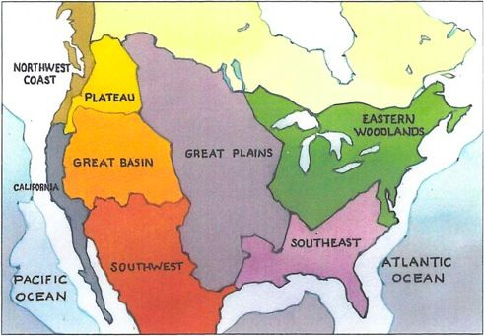
Requirement 1
Identify the different American Indian cultural areas. Explain what makes them each unique.

Slide 6
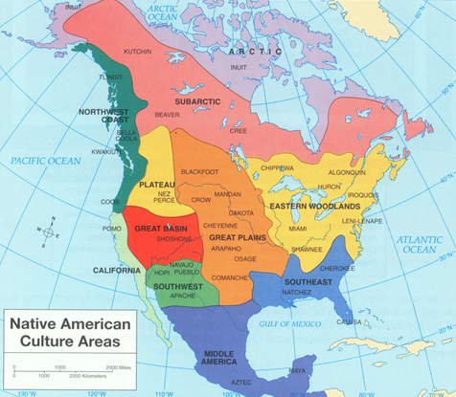
Native American Cultural Areas
Many thousands of years before Christopher Columbus’ ships landed in the Bahamas, a different group of people discovered America: the ancestors of modern Native Americans who hiked over a “land bridge” from Asia to what is now Alaska more than 12,000 years ago
As time passed, these migrants and their descendants pushed south and east, adapting as they went.
In order to keep track of these diverse groups, anthropologists and geographers have divided them into “culture areas,” or rough groupings of contiguous peoples who shared similar habitats and characteristics.
10 separate culture areas: the Arctic, the Subarctic, the Eastern Woodlands, the Southeast, the Plains, the Southwest, the Great Basin, California, the Northwest Coast and the Plateau.

Slide 7
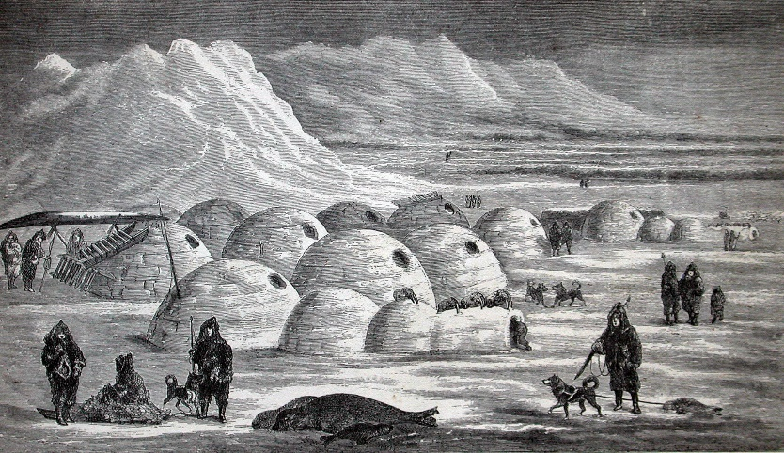
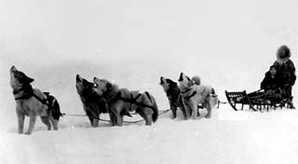
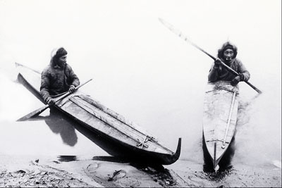
Arctic Culture Area
The Arctic culture area, a cold, flat, treeless region near the Arctic Circle in present-day Alaska, Canada and Greenland, was home to the Inuit and the Aleut.
Both groups spoke dialects from the Eskimo-Aleut language family.
The Arctic’s population was small and scattered.
  The Inuit in the northern part of the region, were nomads, following seals, polar bears and other game as they migrated across the tundra. In the southern part of the region, the Aleut were a bit more settled, living in small fishing villages along the shore.
The Inuit and Aleut lived in dome-shaped houses made of sod, timber, or in the North, ice blocks.
They used seal and otter skins to make warm, weatherproof clothing, aerodynamic dogsleds and long, open fishing boats (kayaks in Inuit; baidarkas in Aleut).

Slide 8
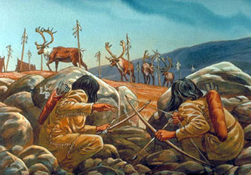
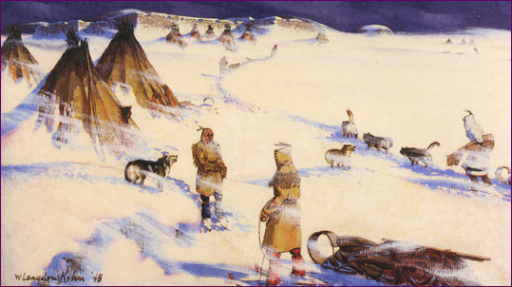
Subarctic Culture Area
The Subarctic culture area, mostly composed of swampy, piney forests (taiga) and waterlogged tundra, stretched across much of inland Alaska and Canada.
Scholars have divided the region’s people into two language groups: the Athabaskan speakers at its western end and the Algonquian speakers at its eastern end.
In the Subarctic, travel was difficult—toboggans, snowshoes and lightweight canoes were the primary means of transportation—and population was sparse.
In general, the peoples of the Subarctic did not form large permanent settlements; instead, small family groups stuck together as they traipsed after herds of caribou.
They lived in small, easy-to-move tents and lean-tos, and when it grew too cold to hunt they hunkered into underground dugouts.

Slide 9
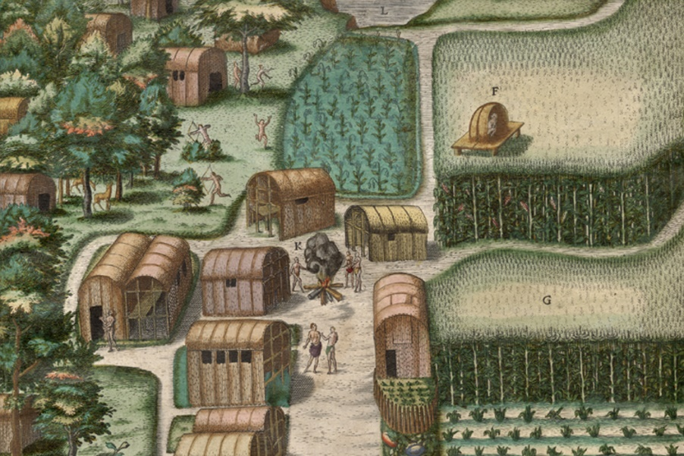
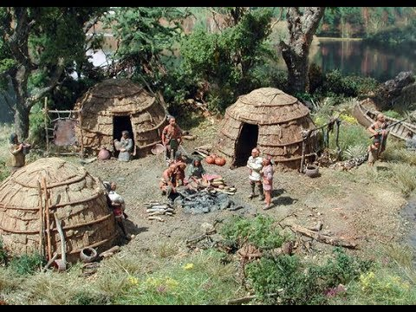
Eastern Woodlands Culture Area
The Northeast culture area stretched from present-day Canada’s Atlantic coast to North Carolina and inland to the Mississippi River valley.
Its inhabitants were members of two main groups: Iroquoian speakers, most of whom lived along inland rivers and lakes in fortified, politically stable villages, and the more numerous Algonquian speakers who lived in small farming and fishing villages along the ocean.
  There, they grew crops like corn, beans and vegetables.
Life in the Northeast culture area was fraught with conflict—the Iroquoian groups tended to be rather aggressive and warlike, and bands and villages outside of their allied confederacies were never safe from their raids.

Slide 10
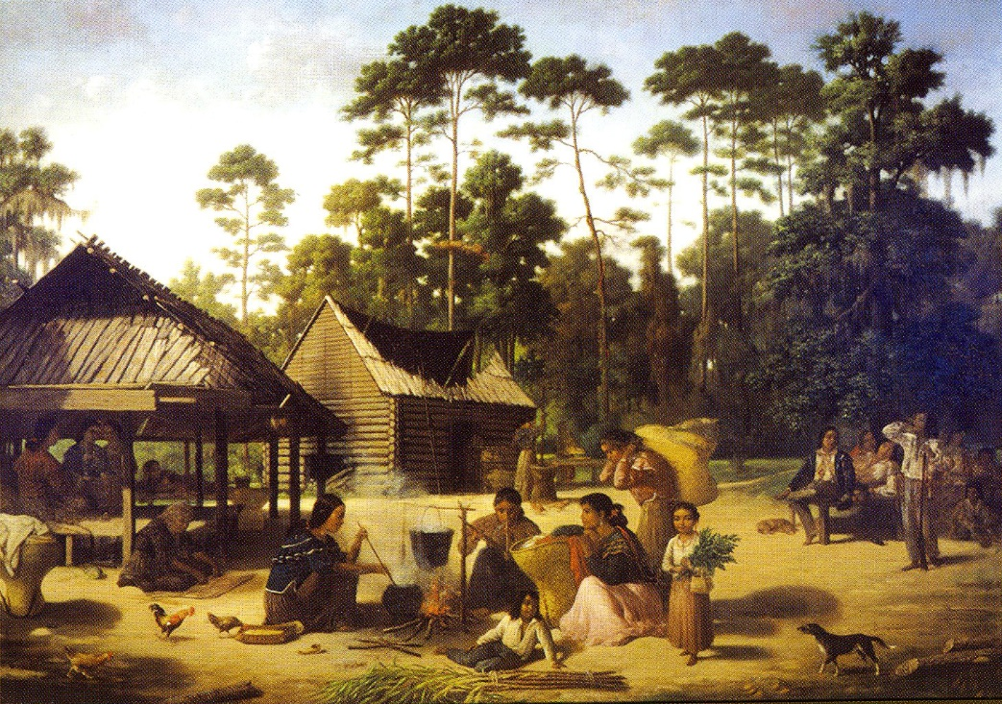
Southeast Culture Area
The Southeast culture area, north of the Gulf of Mexico and south of the Northeast, was a humid, fertile agricultural region.
Many of its natives were expert farmers and grew staple crops like maize, beans, squash, tobacco and sunflower.
They organized their lives around small ceremonial and market villages known as hamlets.
The most familiar of the Southeastern Indigenous peoples are the Cherokee, Chickasaw, Choctaw, Creek and Seminole, sometimes called the Five Civilized Tribes, some of whom spoke a variant of the Muskogean language.

Slide 11
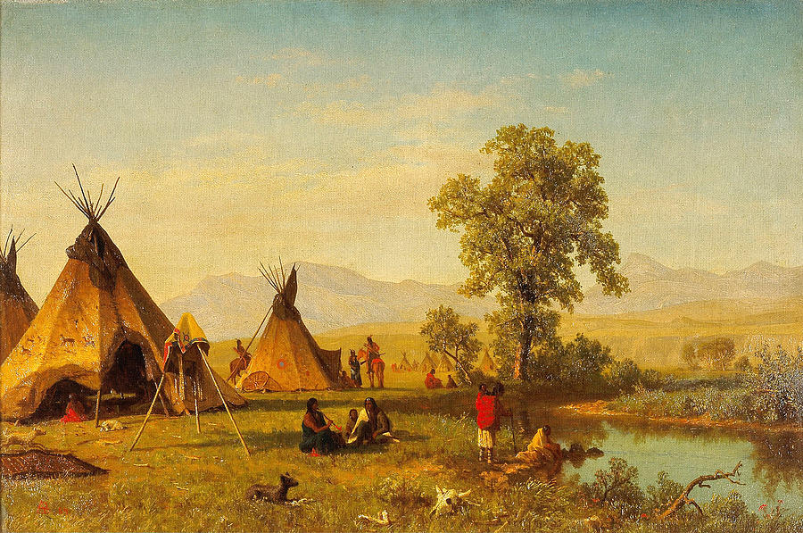
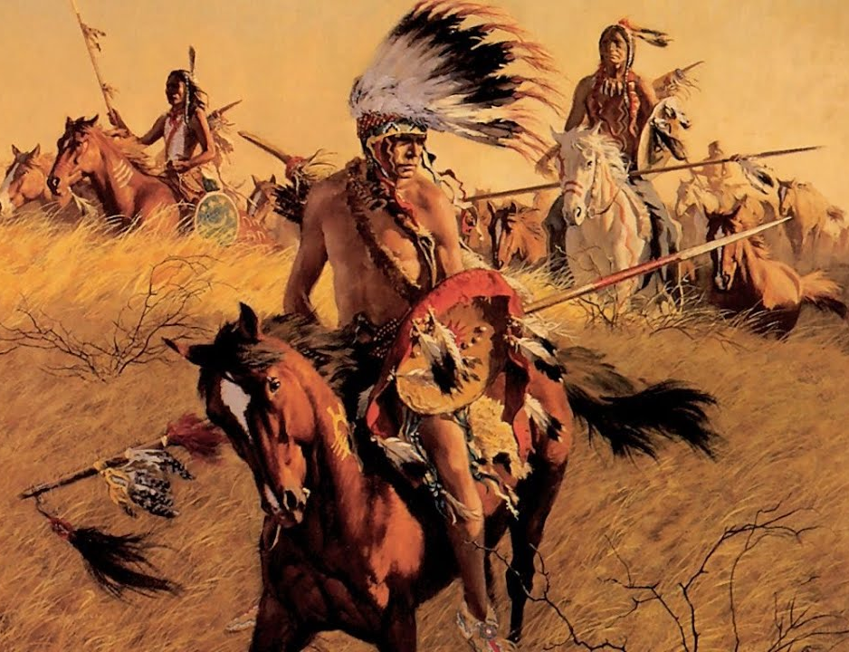
Great Plains Culture Area
The Plains culture area comprises the vast prairie region between the Mississippi River and the Rocky Mountains, from present-day Canada to the Gulf of Mexico.
Before the arrival of Europeans, its inhabitants were relatively settled hunters and farmers.
  After Spanish colonists brought horses to the region in the 18th century, the peoples of the Great Plains became much more nomadic.
  Groups like the Crow, Blackfeet, Cheyenne, Comanche and Arapaho used horses to pursue great herds of buffalo across the prairie.
The most common dwelling for these hunters was the cone-shaped teepee, a bison-skin tent that could be folded up and carried anywhere.
Plains Indians are also known for their elaborately feathered war bonnets.

Slide 12
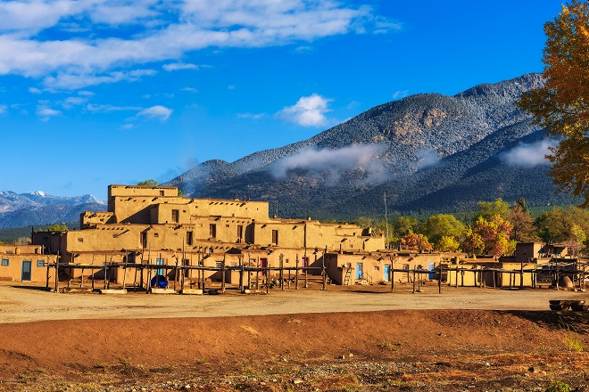
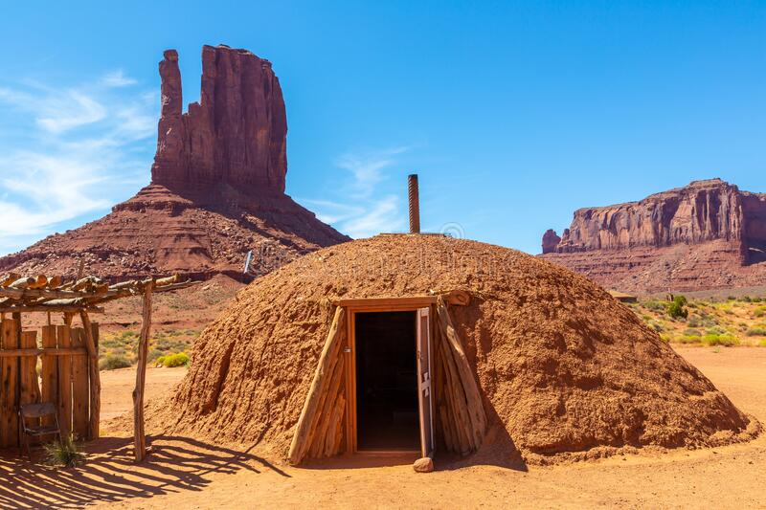
Southwest Culture Area
The peoples of the Southwest culture area, in present-day Arizona and New Mexico (along with parts of Colorado, Utah, Texas and Mexico) developed two distinct ways of life.
  Sedentary farmers such as the Hopi, the Zuni, the Yaqui and the Yuma grew crops like corn, beans and squash.
    Many lived in permanent settlements, known as pueblos, built of stone and adobe.
    These pueblos featured great multistory dwellings that resembled apartment houses.
    At their centers, many of these villages also had large ceremonial pit houses, or kivas.
  Other Southwestern peoples, such as the Navajo and the Apache, were more nomadic.
    They survived by hunting, gathering and raiding their more established neighbors for their crops.
    Because these groups were always on the move, their homes were much less permanent than the pueblos.

Slide 13
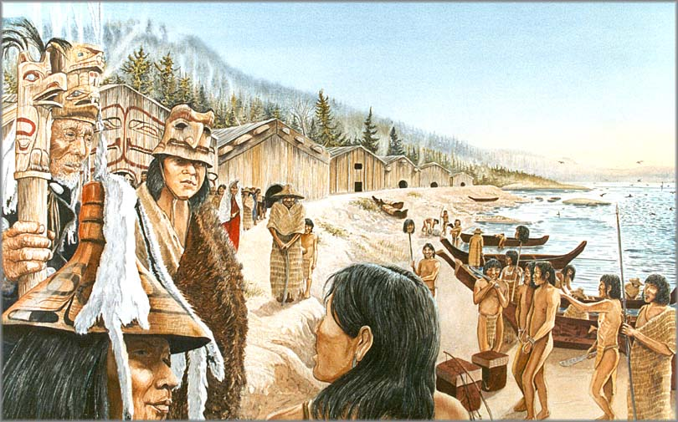
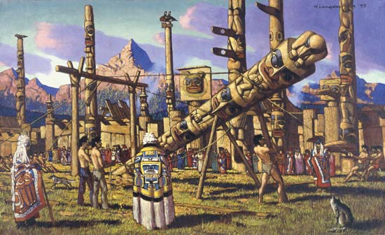
Northwest Culture Area
The Northwest Coast culture area, along the Pacific coast from British Columbia to the top of Northern California, has a mild climate and an abundance of natural resources.
In particular, the ocean and the region’s rivers provided almost everything its people needed—salmon, especially, but also whales, sea otters, seals and fish and shellfish of all kinds.
The Indians of the Pacific Northwest were secure enough to build permanent villages that housed hundreds of people apiece.
Those villages operated according to a rigidly stratified social structure.
  A person’s status was determined by his closeness to the village’s chief and reinforced by the number of possessions—blankets, shells and skins, canoes and even slaves—he had at his disposal.

Slide 14
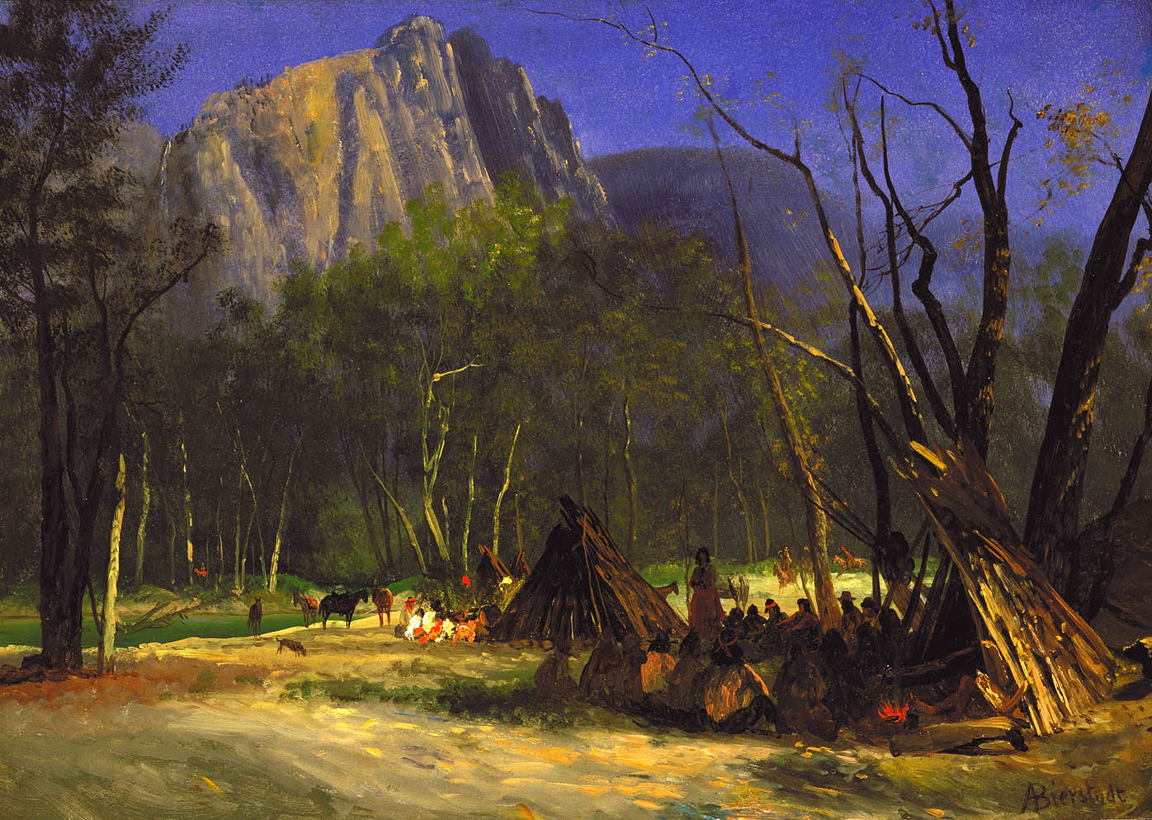
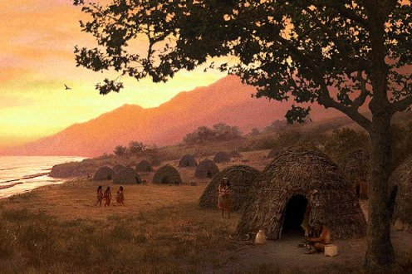
California Culture Area
Before European contact, the temperate, hospitable California area had more than any other and was also more diverse.
Its estimated 100 different tribes and groups spoke more spoke more than 200 dialects.
Despite this great diversity, many native Californians lived very similar lives.
They did not practice much agriculture. Instead, they organized themselves into small, family-based bands of hunter-gatherers known as tribelets.
Inter-tribelet relationships, based on well-established systems of trade and common rights, were generally peaceful.

Slide 15
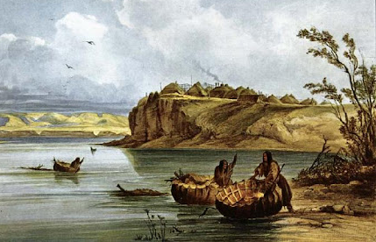
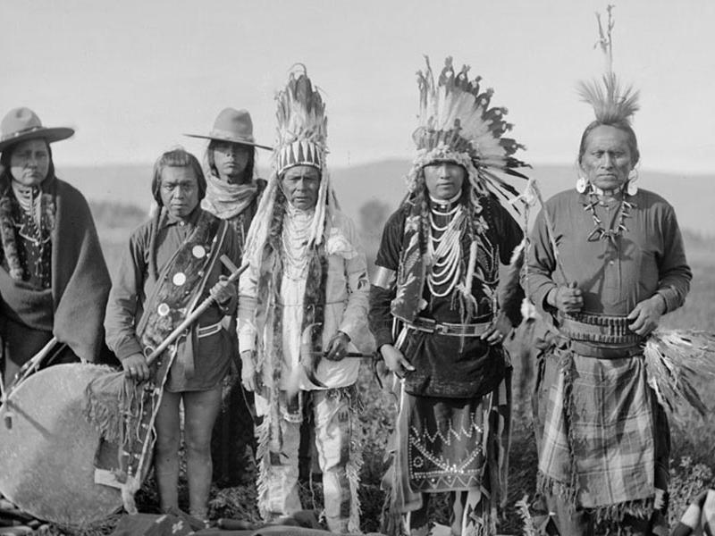
Plateau Culture Area
The Plateau culture area sat in the Columbia and Fraser river basins at the intersection of the Subarctic, the Plains, the Great Basin, the California and the Northwest Coast (present-day Idaho, Montana and eastern Oregon and Washington).
Most of its people lived in small, peaceful villages along stream and riverbanks and survived by fishing for salmon and trout, hunting and gathering wild berries, roots and nuts.
In the 18th century, other native groups brought horses to the Plateau and the region’s inhabitants quickly integrated the animals into their economy, expanding the radius of their hunts and acting as traders and emissaries between the Northwest and the Plains.

Slide 16
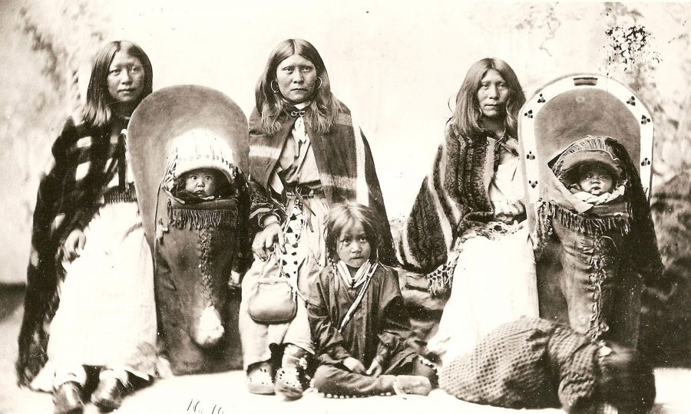
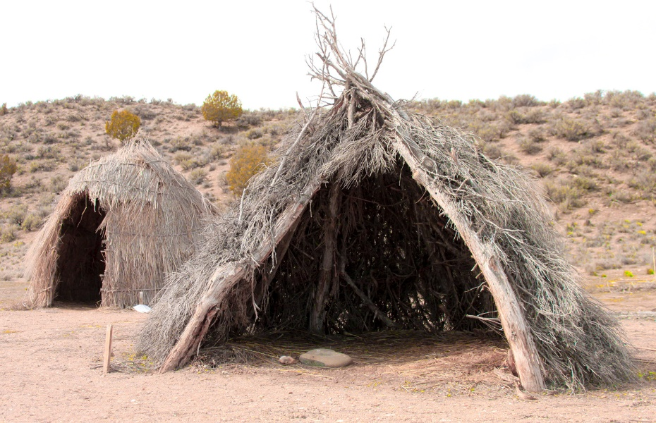
Great Basin Culture Area
The Great Basin culture area, an expansive bowl formed by the Rocky Mountains to the east, the Sierra Nevada's to the west, the Columbia Plateau to the north, and the Colorado Plateau to the south, was a barren wasteland of deserts, salt flats and brackish lakes.
Its people, most of whom spoke Shoshonean, foraged for roots, seeds and nuts and hunted snakes, lizards and small mammals.
Because they were always on the move, they lived in compact, easy-to-build wikiups made of willow poles or saplings, leaves and brush.
Their settlements and social groups were impermanent, and communal leadership (what little there was) was informal.

Slide 17
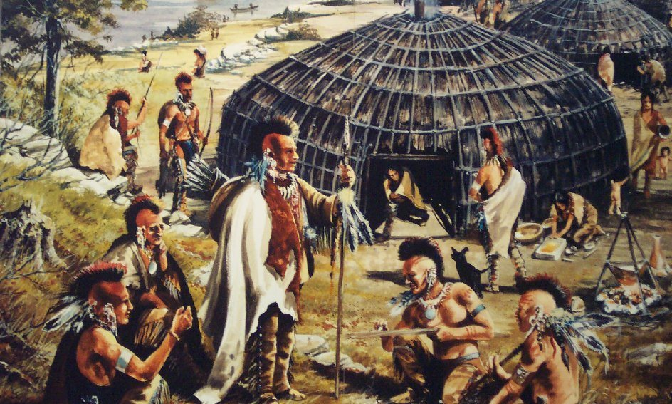
Requirement 2
Give the history of one American Indian tribe, group or nation that lives or has lived near you. Visit it, if possible. Tell about traditional dwellings, way of life, tribal government, religious beliefs, family and clan relationships, language, clothing styles, arts and crafts, food preparation, means of getting around, games, customs in warfare, where members of the group now live, and how they live.

Slide 18
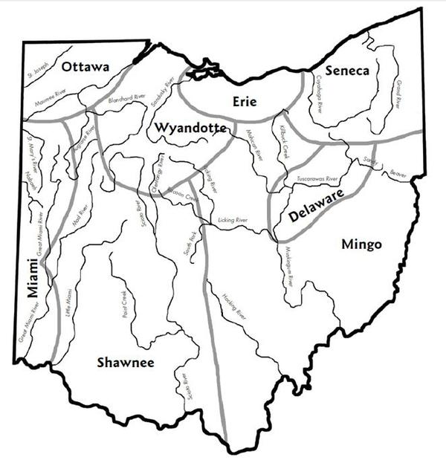
Native Americans in Ohio
Ohio was occupied by numerous American Indian tribes.
  In the northwest, the Wyandot were located along the banks of the Maumee and Sandusky rivers.
  The Shawnee, in the south were located on both sides of the Scioto.
  The Miami occupied the valleys of the two Miami rivers
  The Mingo located in the southeast between the Muskingum and Ohio rivers.
  The Delaware, Ottawa, and Chippewa people were scattered throughout.“
The last Indian tribe left Ohio in 1843.

Slide 19
Traditional Dwellings
The teepee was generally used as a temporary shelter in a hunting camp.
This cone-shaped tent had a framework of long poles placed in a circle, set upright they would lean together at the top.
This frame was covered with mats or bark.
Mats were made of cattails, or “flags,” stitched together in sections of about five by fifteen feet.
These lightweight mats were easy to transport when rolled up.

Slide 20
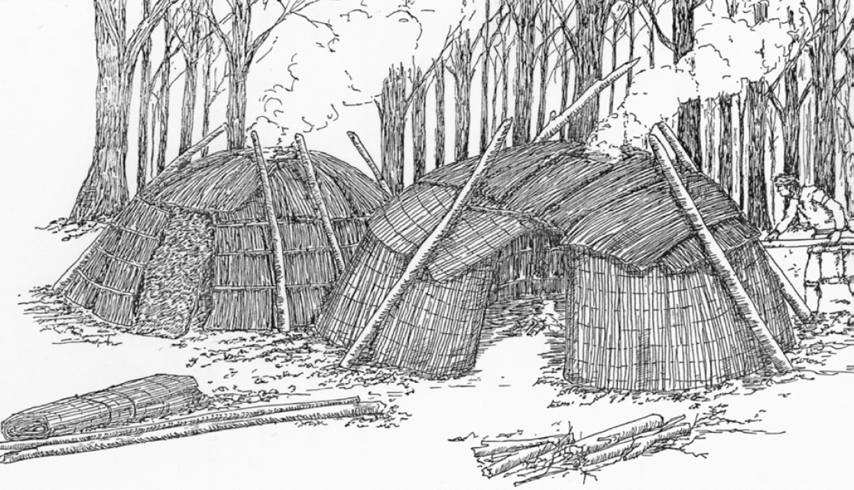
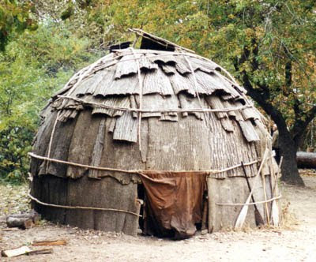
Traditional Dwellings
The wigwam was a circular, or oval, dome-shaped structure that housed one or two families.
The butt-ends of the pole or sapling frame were imbedded in the earth; the tapered ends were bent down and tied in place with bark strips.
Over this frame was fastened a covering of bark or mats, sometimes a combination of both.
Mats were made of cattails, or common marsh “flags,” as they were called.
In the center of the domed roof was a smoke hole with a section of bark on a long pole resting against the side of the wigwam that could be adjusted to keep the wind from blowing the campfire smoke back inside.

Slide 21
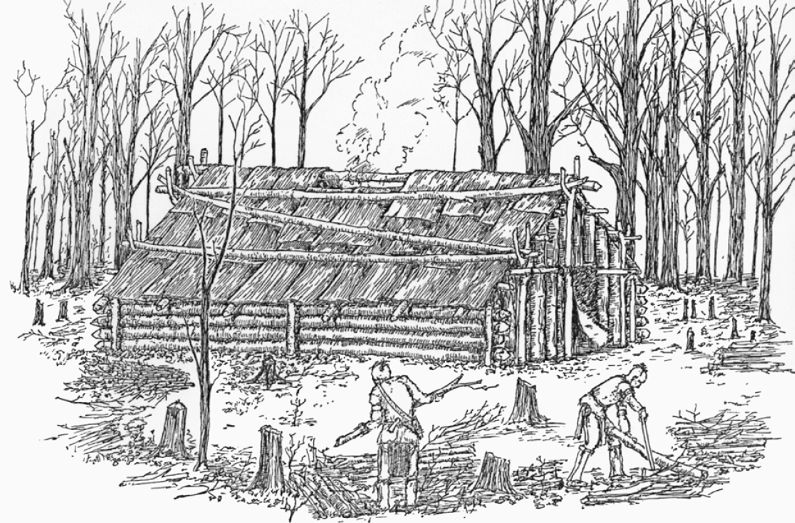
Traditional Dwellings
The log house resembled a frontier log cabin.
The structure was rectangular with side walls of small logs four feet or more in height and fifteen feet long.
Logs were not notched but were laid between pairs of posts driven into the ground at each end and tied together at the top with bark strips.
End walls about twelve feet long were made of split logs set upright in the ground.
Stout forked posts at either end supported the ridgepole.
From the side walls to the ridge pole, small poles were laid and tied in place to serve as rafters. The roof frame was covered with slabs of bark, overlapped and tied in place.
Cracks between the logs were stuffed with moss.
Bear skins were hung over the openings at each end to serve as doors.
Living quarters were on the sides; a series of small fires were laid in the middle down the length of the cabin.
An opening in the roof served as a chimney.

Slide 22
Traditional Dwellings
The longhouse design was generally associated with the Iroquois and sometimes with the Delaware and Shawnee tribes.
The longhouse was a multi-family dwelling, from thirty to more than one-hundred feet in length, and about twenty-five feet wide, and twelve to fifteen feet high. The Iroquois used a rounded or Quonset-type roof, while the Delaware and Shawnee used a pitched or peaked roof.
Poles and saplings bound together with tough bark strings formed the framework. This was covered with large sheets of elm or birch bark, overlapping and tied in place to make a weatherproof covering.
Inside there would be a passageway down the center that contained fireplaces or pits for cooking and heating. There was a smoke hole in the roof over each fire pit. The openings at each end of the longhouse were usually covered with a large animal skin or hide.
Inside, each family lived and slept on raised platforms. These platforms extended along the length of the longhouse on both sides. Placed a foot or two above the ground, these platforms were framed with poles and floored with slabs of bark.

Slide 23
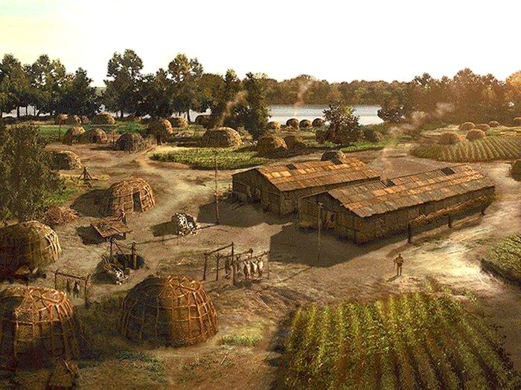
Way of Life
American Indian villages could consist of as many as several hundred dwellings or cabins, or as few as a half a dozen.
The villages were generally located near a stream or large spring.
Good land for gardens and cornfields and a plentiful supply of firewood were important in determining the location of a village.
In prehistoric times, and even after the Europeans arrived in North America, some American Indian tribes fortified their villages with palisades, or walls, as a protection against enemy attack.

Slide 24
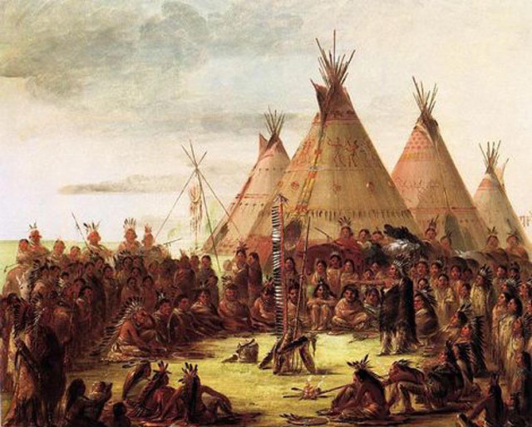
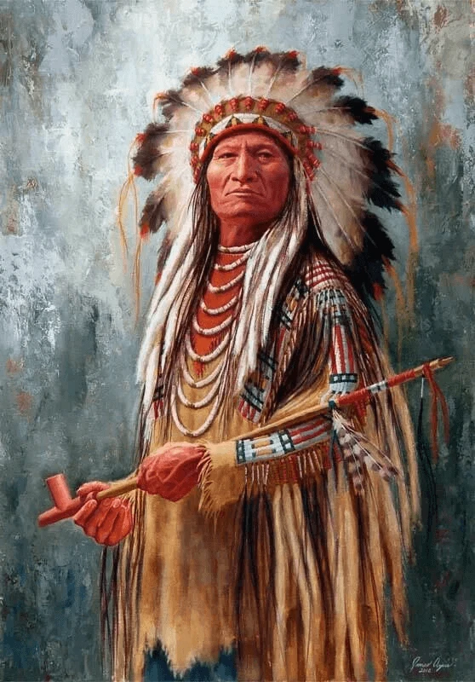
Tribal Government
The chief of a village or several villages would have a council and other city officials, just as cities do today.
Town meetings were pow wows, with singing, dancing, prayers, games, and serious talk.
Some tribes had more than one chief.
  The peace chief was usually a hereditary position.
  The war chief was chosen for his military prowess.
  The shaman, or medicine man, was responsible for religious rituals.

Slide 25
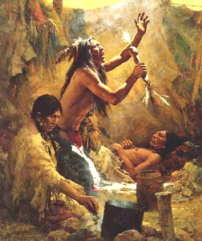
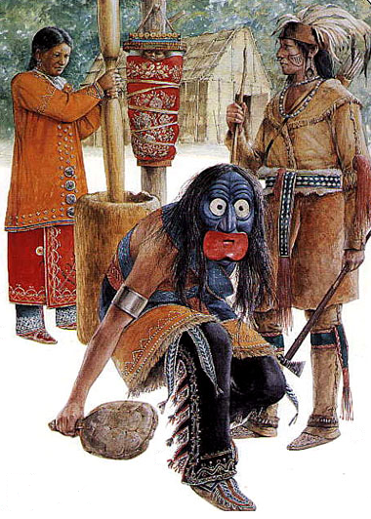
Religious Beliefs
Beliefs and rituals among the Indian tribes were quite varied
The Algonquians believed in forces called Manitou, which had many different forms.
Spirits were in all things, animals, plants, water, rocks, the sun, the moon, weather, and even sickness.
Shamans were supposed to be able to control these spirits.
Each person was thought to have a personal, protective spirit.
Some tribes had sacred societies with special rites, signs, and symbols.
  Examples include the Grand Medicine Society of the Ojibwa and the False Face Society of the Iroquois (organizations of healers).

Slide 26
Family and Clan Relationships
Many tribes from the Northeast, Southeast, and Southwest were matrilineal, meaning they traced their ancestry through the mother’s side and married couples lived near the wife's family .
  The tribes of the Great Plains, were patrilineal.
The oldest woman in the longhouse was supreme.
  She was “mother” to the entire household in the sense that it belonged to her and her female relatives.
The clan mother, with the advice of other women of her tribe, appointed each of the councilor chiefs.
  If the councilor chief failed in his duties, the women could remove him from office.
Although groups maintained a division of labor by gender, they had economic, political, and social freedom for both women and men.
  Women's and men's responsibilities were thought of as parallel rather than hierarchical.
  Although child rearing was predominantly a female task, men and women of all ages worked together to raise children.
  Both men and women initiated divorce, which was common and not considered immoral.

Slide 27
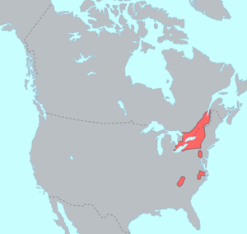
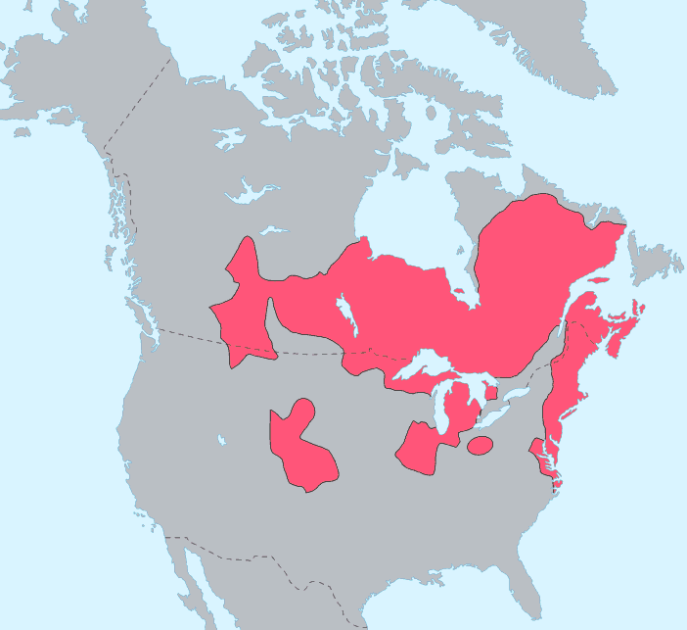
Language
Iroquoian Language Map
The Northeast Native American culture area covered the Atlantic coast from Canada to North Carolina and the languages were divided into two groups.
The tribes of the Erie, Onondaga, Seneca, Tuscarora, Cayuga and Oneida people spoke the Iroquoian language.
The tribes of the Menominee, Pequot, Delaware, Fox, Shawnee and Wampanoag spoke the Algonquian language.
Algonquian Language Map

Slide 28
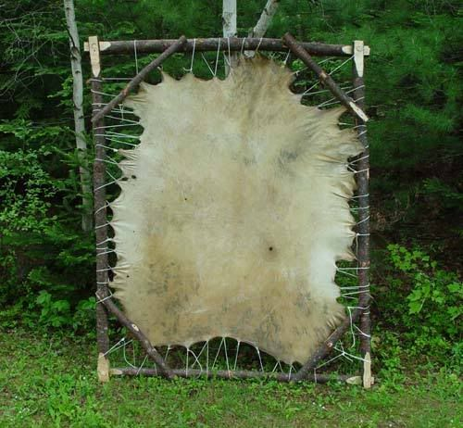
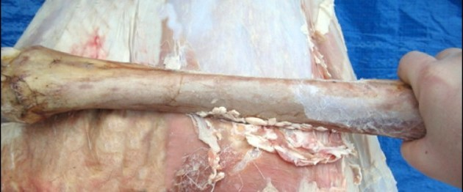
Clothing Style
Before the arrival of the Europeans, the attire of the American Indian was simple and functional. Their clothing was made of animal skins. However, the process of turning the hide of a deer or buffalo into garments was a long, hard job.
Once the hunt of the animal was successful, using tools made of flint, stone, bone, or shells, the animal was carefully skinned then butchered for food.
The women of the tribe took the hide back to camp, stretched it, and staked it on the ground fur side down. Using various handmade tools, the skin was scrapped free of matter. If the skin were to be used for warmth, the fur would have been left intact, if not, the hide would have been flipped over and the hair removed.
Once all debris was removed, the skin was rubbed with a mixture of animal fat, brains, and liver then placed aside for several days to allow it to soften. The hide was then washed and worked over to smooth the leather.
Finally, it was tanned by mounting it on a frame over a low fire. This smoking process gave the leather its rich color.

Slide 29
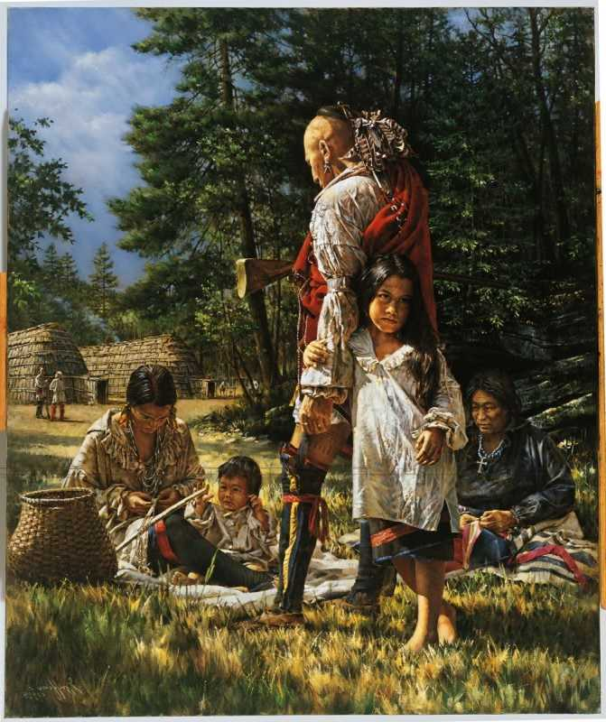
Clothing Style
Men usually wore a breech cloth made from a rectangular piece of leather. It would be placed between the legs and brought up in front and back then held in place with a leather cord or belt fastened around the waist. A shirt would take two deer skins, each cut into three pieces. The body of the animal formed the shirt and the front legs were used to make sleeves.
Women would wear a large rectangular skin wrapped around their waist and held in place with a leather strap. A dress required two deer skins sewn together with sinew across the top and down the sides.
Left over leather could be used to make moccasins. In the winter weather, leggings, capes, or jackets would be layered for warmth. All wearing apparel may have been beaded, painted, or fringed for decoration.
Once trade began with the Europeans, the dress of the American Indian changed to include woven fabrics of bright colors; this added prestige to their wardrobe.

Slide 30
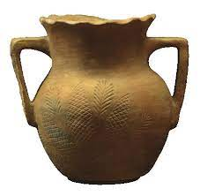
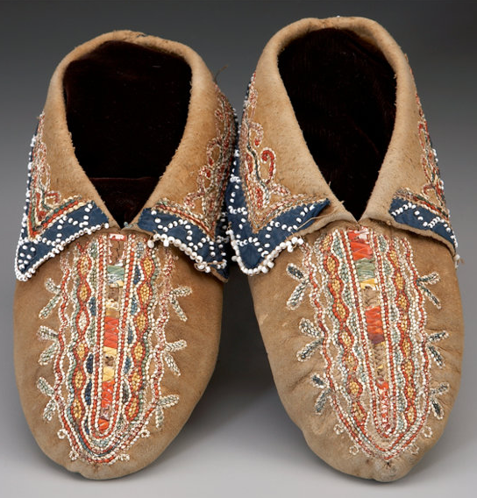
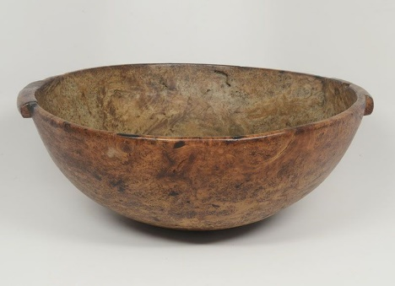
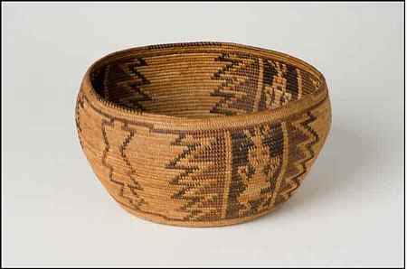

Arts and Crafts
The Woodland Indians used materials at hand to shape tools, weapons, and ceremonial objects.
Wood, bark, and other plant materials, and stone, clay, hide, bone, antler, shells, quills, and feathers were used.
Later, the Europeans introduced new materials such as metals, glass, and cloth.
Watertight birchbark or the hardwood burls from birch, elm, and maple were used to make bowls, dishes, and trays.
Wooden bowls were made by charring, then scraping the burls.
The shredded bark of trees such as basswood was twisted to make twine for sewing.
They plaited baskets from sweetgrass and wood splints and used clay for pottery dishes.

Slide 31
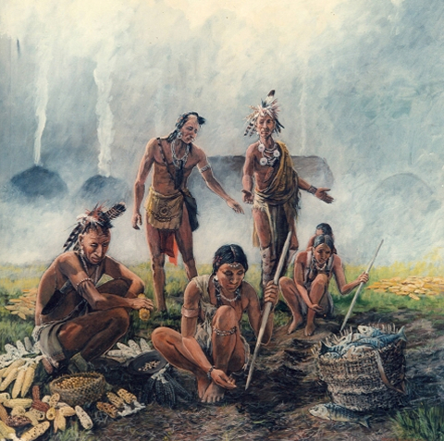
Food Preparation
The Woodland Indian tribes of the Great Lakes area and throughout the eastern and southern part of the present United States were farmers.
  Corn, beans, squash, pumpkin, turnips, cabbage, parsnips, sweet potatoes, yams, potatoes, onions, and leeks were widely grown.
In the spring, the American Indians made maple sugar in large quantities.
They also harvested nuts, berries, wild plums, wild cherries, and paw paws.
In the great lakes region, wild rice was gathered.
Protein was supplemented in the diet by fishing.
In the fall and winter, the American Indian hunted and trapped beaver, muskrat, raccoon, deer, buffalo, and black bear for the meat and hides.
Most Eastern Woodlands Indians cooked their food in clay pots and stored food in a birch bark container called a makak.

Slide 32
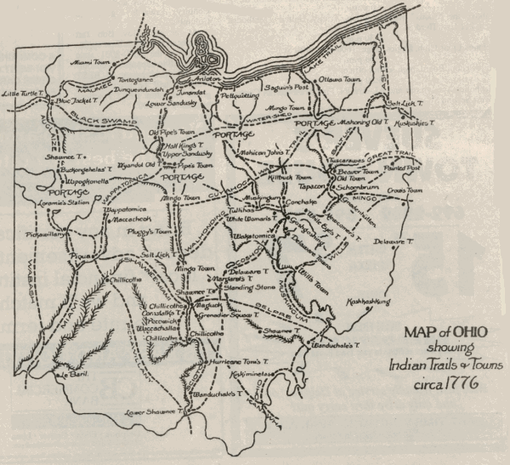
Means of Getting Around
The original traces or paths through the dense forests of Ohio were created by animals -such as buffalo and deer- in search of food, water, and salt licks.
  These trails were far enough from streams to avoid swamps and lowlands and sometimes followed the ridges, and became known as “high-ways.”
  These paths were narrow and well worn in and difficult to travel.
  Because of this, early people and explorers traveled single file when they used these traces to pursue game and to get flint.
The most important trails ran north and south for they connected Lake Erie with the Ohio River.

Slide 33
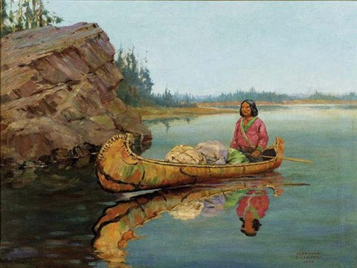
Means of Getting Around
The birch bark canoes plied the rivers and lakes of the Northeast woodlands.
The Native Americans used the light, swift watercraft to hunt, fish, trade, and make war.
These lightweight canoes could easily be portaged, or carried from one waterway to another.
They were constructed in all sizes, from small, two-person craft to large canoes for eight to 10 people.
On the trail, they served as shelter from the elements.
Cedar was normally used for the framework. The bark of birch, peeled from the trees in large sheets, did not shrink or stretch and was ideal for the covering.
Bark pieces were sewn together with spruce roots and shaped around the frame. Spruce tree resin waterproofed the seams. The braces and paddles were made of maple.

Slide 34
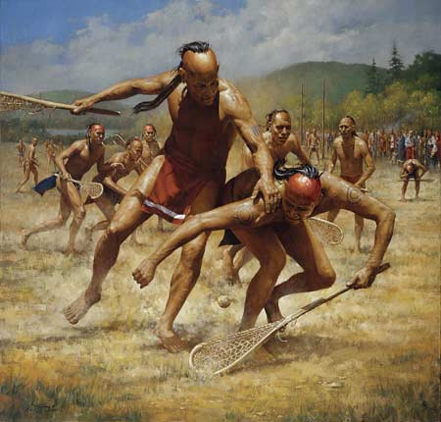
Games
Lacrosse has its origins in a tribal game played by all eastern Woodlands Native Americans.
As many as 100 to 1,000 men from opposing villages or tribes would participate.
They played over huge open areas between villages and the goals, which might be trees or other natural features, were anything from 500 yards to several miles apart.
The rules were very simple, the ball was not to be touched by a player’s hand and there were no boundaries.
The ball was tossed into the air to indicate the start of the game and players raced to be the first to catch it.
Tripping, hitting, tackling and piling on one another were part of the game and injuries were common.
Games of lacrosse were played for a number of reasons:
  It was considered a sport that toughened up young warriors for war but it was also a game played for recreation and for religious reasons.

Slide 35
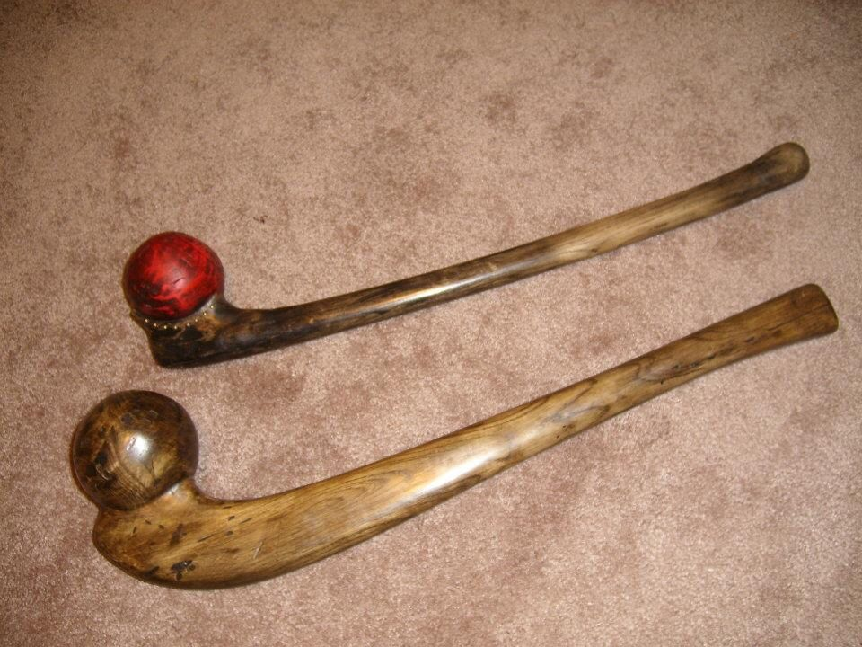
Customs in Warfare
Purpose:
The indigenous peoples living throughout the eastern half of North America engaged in low-intensity, low-casualty conflicts known as blood feuds or mourning wars.
Indians fought these wars for several reasons:
  First, blood feuds were a way for Native Americans to avenge the deaths of kin or tribesmen murdered by other Indians.
  Second, mourning wars gave young men the opportunity to earn the prestige needed to become respected and influential members of their tribe.
  Third, taking captives satisfied demographic needs by providing a source of replacements for a tribe’s deceased members.
Woodland War Clubs

Slide 36
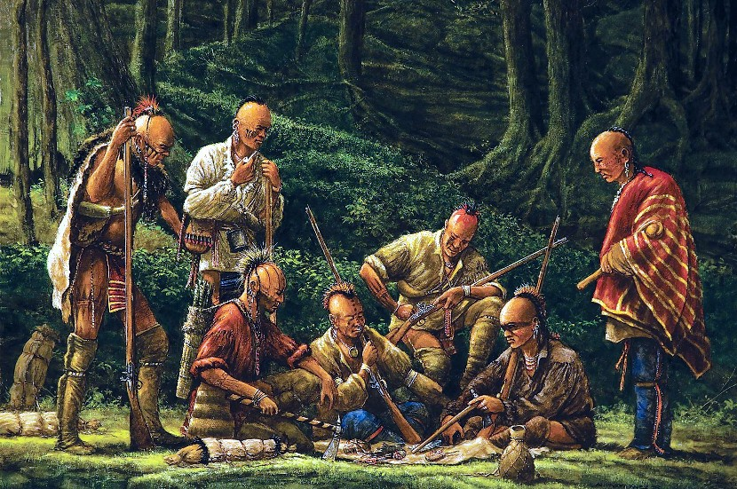
Customs in Warfare
Typical Campaign.
Woodland Indian military operations generally occurred during the warmer months to take advantage of the cover that foliage provided.
The typical campaign began when clan matriarchs commissioned a male war chief to avenge the death of a family member.
After assembling a raiding party, gaining village approval, and holding a ceremonial feast, the war chief led his men into battle.
Upon entering the foe’s territory, the war party split into smaller groups of five or six that established ambushes near fields or along paths frequented by the enemy.
Ambushing Indians enjoyed surprise and were usually one-sided affairs that ended with the taking of captives.

Slide 37
Customs in Warfare
The Captives’ Fate.
Enemy Indians taken captive in mourning wars confronted several fates.
Women and children who were a burden and enemy warriors perceived to be a threat were, on occasion, scalped and killed immediately.
In general, however, prisoners were bound and led back to their captors’ home village.
The tribal council assigned each prisoner to a family that had lost relatives to that captive’s tribe.
These captives were given the name, title, and position of the person they replaced, and, over time, became integrated into their new family and became loyal to their new tribe.
Their capture thus eased the pain of bereavement, maintained the size of family, clan, and tribe, and restored the spiritual strength that the community had lost through the death of a member.

Slide 38
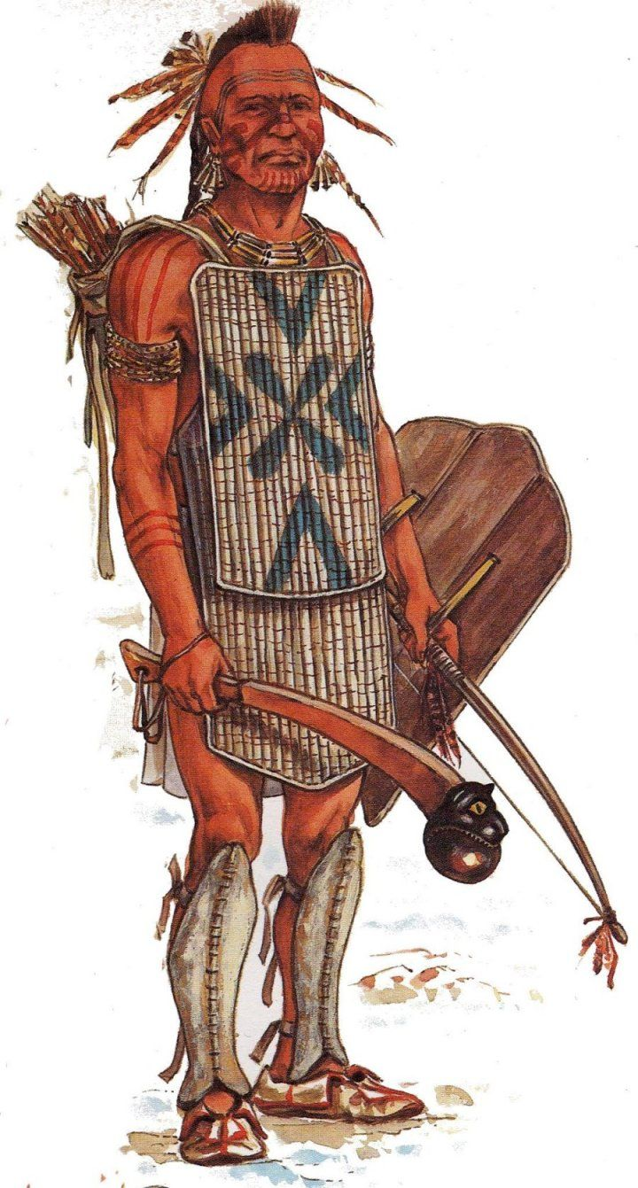
Customs in Warfare
Indian Weapons.
The weapons of the European pre-contact period were well suited to the Native Americans’ preferred strategies and tactics.
Indian weapons such as stone-headed axes, wooden clubs, and spears lent themselves well to ambushes and surprise attacks.
Bows that fired stone-tipped arrows were likewise employed in such engagements, though they had only a short effective range and were of limited value in the thickly forested eastern part of the continent.
For protection, Indian warriors carried bark shields and wore crude wooden armor over their torsos and legs.

Slide 39
Where Members Now Live and How They Live
Today, the Cayuga, Oneida, Onondaga, Seneca, Mohawk, and Tuscarora maintain headquarters in New York.
There are Narragansett in Rhode Island, Pequot in Connecticut, Micmac, Passamaquoddy, and Penobscot in Maine, and Sac and Fox in Iowa.
There are Chippewa in Minnesota, Wisconsin, Montana, and Canada.
  Also in Wisconsin are Menominee, Potawatomi, and Oneida.
There are three major tribal groups in Michigan: the Chippewa, Ottawa, and Potawatomi
Today, 78% of Native Americans live off-reservation, and 72% of those live in urban or suburban environments. The remaining 22% of our country’s 5.2 million Native Americans live on tribal lands (2010 U.S. Census).

Slide 40
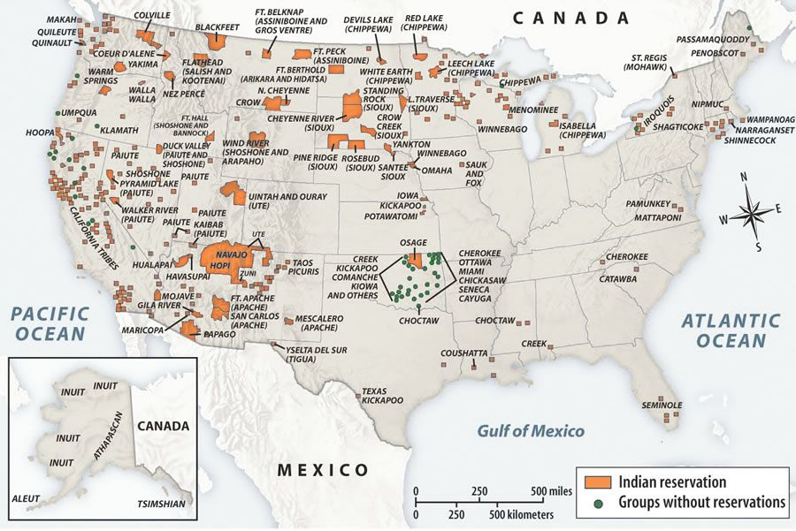
Native American Tribal Lands

Slide 41
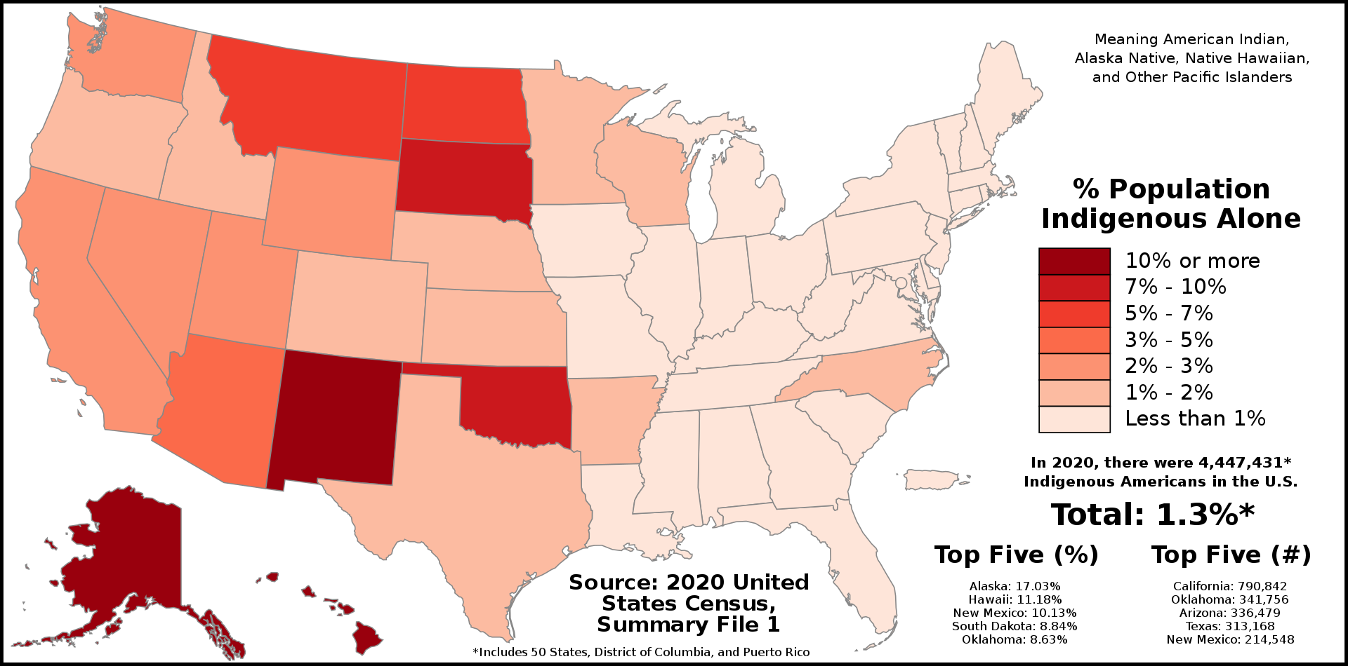
Native Americans in the U.S.

Slide 42
Requirement 3
Do TWO of the following. Focus on a specific group or tribe.
  Make an item of clothing worn by members of the tribe.
  Make and decorate three items used by the tribe, as approved by your counselor.
  Make an authentic model of a dwelling used by an Indian tribe, group, or nation.
  Visit a museum to see Indian artifacts. Discuss them with your counselor. Identify at least 10 artifacts by tribe or nation, their shape, size, and use.

Slide 43

Native American Technology and Art
Native American Technology and Art is an internet resource focusing on the arts of Eastern Woodland Indian Peoples.
It provides historical and contemporary background along with instructional how-to's and references for making clothing and a variety of items used by the tribes.
Decorated feathers are often tied to a lock of hair, placed upright on top of a cap, fastened to a headband or worn from the ears.

Slide 44
Requirement 3
Do TWO of the following. Focus on a specific group or tribe.
  Make an item of clothing worn by members of the tribe.
  Make and decorate three items used by the tribe, as approved by your counselor.
  Make an authentic model of a dwelling used by an Indian tribe, group, or nation.
  Visit a museum to see Indian artifacts. Discuss them with your counselor. Identify at least 10 artifacts by tribe or nation, their shape, size, and use.

Slide 45


Dwellings of Native Americans
See slides 19-22 for traditional dwellings and construction techniques of the Northeast Woodlands Native Americans.

Slide 46
Requirement 3
Do TWO of the following. Focus on a specific group or tribe.
  Make an item of clothing worn by members of the tribe.
  Make and decorate three items used by the tribe, as approved by your counselor.
  Make an authentic model of a dwelling used by an Indian tribe, group, or nation.
  Visit a museum to see Indian artifacts. Discuss them with your counselor. Identify at least 10 artifacts by tribe or nation, their shape, size, and use.

Slide 47
Native American Culture Exhibits in Ohio
  Here is a list of some places to visit in Ohio to learn about Native American culture:
    Allen County Museum 620 W. Market St. Lima, OH 45801 phone (419) 222-9426
    The Cleveland Museum of Natural History 1 Wade Oval Dr, Cleveland, OH 44106 phone (216) 231-4600
    Boonshoft Museum of Discovery 2600 DeWeese Pkwy. Dayton, OH 45414 phone (937) 275-7431
    Ohio History Center I-71 & 17th Avenue (Exit 111) Columbus, OH 43211 phone 800.686.6124
    Serpent Mound Museum 3850 State Rte. 73 Peebles, OH 45660 phone 800.752.2757
    Wood County Museum 13660 County Home Rd. Bowling Green, OH 43402 phone (419) 352-0967

Slide 48
Requirement 4
Do ONE of the following:
  Learn three games played by a group or tribe. Teach and lead one game with a Scout group.
  Learn and show how a tribe traditionally cooked or prepared food. Make three food items.
  Give a demonstration showing how a specific Indian group traditionally hunted, fished, or trapped.

Slide 49



Games
Double Ball Game
This game was played by nations of the Eastern Woodlands including Meskwaki, Ojibwa, and Ho-Chunk.
The game is played by 2 or 3 opposing teams and the goals could be up to a mile apart.
The object is to pass the double ball from stick to stick down the field to a goal post.
It is most often played by women and girls.
Female athletes were admired in these cultures and star players had high status

Slide 50

Games
STICK DICE
2 to 8 players
Equipment: 3 flat sticks, 3 inches long, patterned on one side, plain on the other.
Play: Players take turns tossing the dice. Sticks are tossed up to land on flat surface. All three plain sides equal 10 points or counters (tooth picks or corn kernels if used), 2 plain and 1 pattern equals 2 counters, 2 patterns and one plain equals 3 counters, and 3 patterns equals 5 counters. Toothpicks, beans, or pebbles may be used as counters. Highest score wins.

Slide 51



Games
Snow Snake
This game is played during the winter.
Snow snakes are hand-made from a flattened or carved piece of wood.
One end of the snow snake is curved up slightly and the other end is notched to make it easier to throw.
The playing teams would pull a log through the snow to form a trough.
The object of the game is to throw the snow snake the farthest distance along the trough made in the snow.
Teams alternate tosses and the distance the snake travels is added to that team’s score and whichever side has the longest total distance – after a predetermined number of rounds – is the winner.

Slide 52

Games
Ring the Stick
For this game, you will need: a willow stick about three feet long and the width of your pinky finger, sinew (fishing line could be a good alternative), and a metal ring (or a stick tied into a ring). This game was used to develop hand-eye coordination on both sides of the body by switching playing hands.
Once put together, as shown in image A above, the goal is to place the ring over the end of the stick.
First, hold the stick with your dominant hand. Using a scooping motion, try to catch the ring with the end of your stick, as shown in image B above.
For a challenge, use your non-dominant hand, or put a smaller or larger size ring at the end of your stick.

Slide 53
Games
Keeper of the Fire
This game was played by many native tribes in the plains, woodland, and coastal areas of the continent. This one teaches stealth and keen listening skills, which were other important skills for survival in the wild.
This game can be played indoors or outdoors, and all you need is a blindfold and three items representing firewood. Craft sticks bundled with yarn or even paint stir sticks work fine.
The “chief” (best if it’s an adult) will place the wood in front of the Fire Keeper, who is seated on his or her knees, hands on lap, and blindfolded. The rest of the players, the Wood Gatherers, will be seated a distance away. The chief declares, “Wood Gatherers, we need wood!”, and points to one of the wood gatherers, whose job it is to stealthily creep up on the Fire Keeper and steal his wood without being detected and tagged by the Fire Keeper. One point per wood piece collected. Wood gatherers may not “rush” the Fire Keeper, as the object is stealth, and the Fire Keeper may only remove his or her hand from her lap to attempt to tag a Wood Gatherer. When the Wood Gatherer’s turn is finished, he or she may play the role of the Fire Keeper.

Slide 54
Requirement 5
Do ONE of the following:
  Write or briefly describe how life might have been different for the European settlers if there had been no native Americans to meet them when they came to this continent.
  Sing two songs in an Indian language. Explain their meanings.
  Learn in an Indian language at least 25 common terms and their meanings.
  Show 25 signs in Indian sign language. Include those that will help you ask for water, for food, and where the path or road leads.
  Learn an Indian story of up to 300 words (or several shorter stories adding up to no more than 300 words). Tell the story or stories at a Scout gathering or campfire.
  Write or tell about eight things adopted by others from American Indians.
  Learn 25 Indian place names. Tell their origins and meanings.
  Name five well-known American Indian leaders, either from the past or people of today. Give their tribes or nations. Describe what they did or do now that makes them notable.
  Attend a contemporary American Indian gathering. Discuss with your counselor what you learned and observed. Include in your discussion any singing, dancing, drumming, and the various men's and women's dance styles you saw.

Slide 55

Native American Sign Language
Download the Native American/American Indian Sign Language Guide that accompanies this presentation to facilitate the learning of Native American sign language.

Slide 56
Requirement 5
Do ONE of the following:
  Write or briefly describe how life might have been different for the European settlers if there had been no native Americans to meet them when they came to this continent.
  Sing two songs in an Indian language. Explain their meanings.
  Learn in an Indian language at least 25 common terms and their meanings.
  Show 25 signs in Indian sign language. Include those that will help you ask for water, for food, and where the path or road leads.
  Learn an Indian story of up to 300 words (or several shorter stories adding up to no more than 300 words). Tell the story or stories at a Scout gathering or campfire.
  Write or tell about eight things adopted by others from American Indians.
  Learn 25 Indian place names. Tell their origins and meanings.
  Name five well-known American Indian leaders, either from the past or people of today. Give their tribes or nations. Describe what they did or do now that makes them notable.
  Attend a contemporary American Indian gathering. Discuss with your counselor what you learned and observed. Include in your discussion any singing, dancing, drumming, and the various men's and women's dance styles you saw.

Slide 57

Native American Stories, Myths, and Legends
Download the Native American Stories, Myths, and Legends that accompanies this presentation to learn a Native American story to share at a Scout gathering or a campfire.

